Slide 1

Reducing Medicare Spending Through Veteran Specialized Care Coordination
We are dedicated to helping deliver timely and quality access of care for our underserved veterans.
Where Healthcare + Housing + Capital Converge
1

Slide 2

Veteran Alliance USA is a 501(c)(3) focusing on better veteran healthcare outcomes in a Value Based Care Model to lower Medicare spending through coordinated care with the VA and community healthcare partners.

Slide 3
About Us
Veteran Alliance USA, a registered 501(c)(3) nonprofit organization, thats dedicated to improving the health outcomes of senior veterans by employing the Value-Based Care Model.
Teams and partnerships trained on the specific social economic needs of veterans to ensure that every veteran is well informed of their VA health benefits and timely access to their care that they deserve.
Our work includes helping veterans at no cost, to access and navigate the VA system successfully.
We work closely with our partners in healthcare to create better outcomes for the care of our veterans.
2

Slide 4
Veteran Population
Year 1 capacity: 10,000 veterans
Average hospitalizations: 2.5/year per veteran
Average ER visits: 3/year per veteran
“We start with 10,000 veterans, a high-risk population with predictable care needs. The model scales every 2,000 veterans within 3 months.”
US Bureau of Census 2023 indicates approximately 495k veterans living in Arizona with half in Maricopa County

Slide 5

Problems Worth Solving
High ER and hospital utilization
Lack of care coordination
Cost-shifting to VA
Achieving higher patient outcomes with cost share spending
Increase efficiency to veterans' healthcare
Community commitment
Quality vs Quantity
Equitable distribution of care
Disparities in healthcare access and outcomes
Educational outreach regarding eligibility for VA healthcare due to confusion and a lack of access for those who are eligible but unable to navigate the system.
Fragmentation of care for veterans- Lack of integrated care model
Institutional Barriers in coordination of care
Veterans require higher social service needs
Delays in care and authorization

Slide 6
Key Interventions & Services
Veteran Alliance Care Coordination Model
Prioritize and personalize interventions (48-72 hour post discharge follow up with assigned veteran case management)
Manage population health cost (Obtaining VA authorization for ancillary care services to cost shift)
Pharmacy reconciliation to VA cost share
Continuum of Care partnerships
Care Coordination across all payer source and providers
Providing an equitable care distribution
Affordable housing placements
Identifying veterans
Outreach and education
Easy VA enrollment process and access for veterans

Slide 7
Key Interventions & Services
Veteran Alliance Care Coordination Model
Eliminating barriers in VA bureaucracy
Combine housing + healthcare coordination
Holding VA to cost share responsibilities
One stop care for veterans cost shared with the VA (VA auth, VA services, Placement, Palliative and hospice care, VA paid caregiving, Housing, Home Health, Home modification, prosthetics, Pharmacy, DME, Medical Supplies,VA LTC, VA paid services not paid by insurances and Medicare )
Social worker experienced with veteran homelessness, addiction, behavioral health, and service connection chronic illnesses
These interventions reduce hospitalizations, ER visits, and SNF stays. An integrated model for better outcome and cost efficiencies alternatives,”

Slide 8
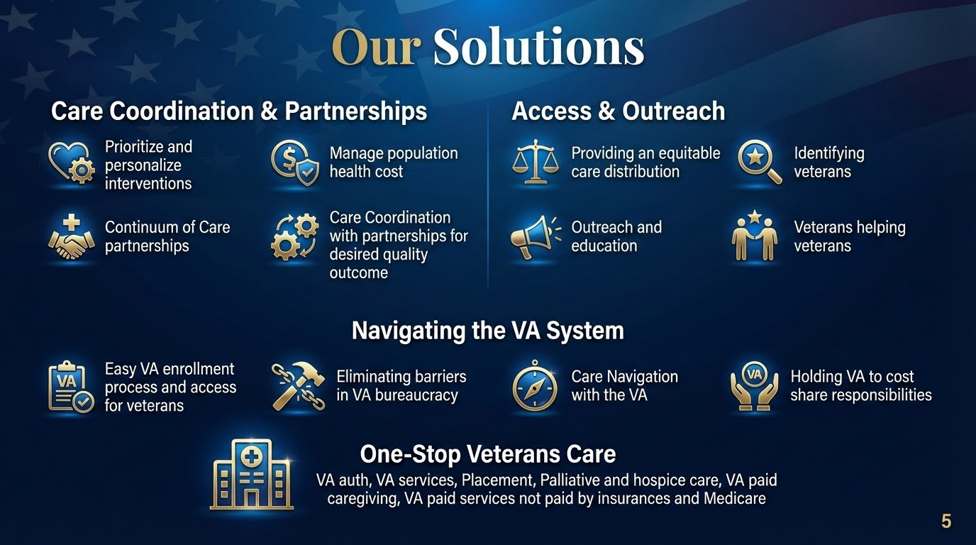

Slide 9
Baseline Utilization & Cost Assumption
Hospitalizations: 10,000 × 2.5 = 25,000 → $15,000 each → $375M
ER visits: 10,000 × 3 = 30,000 → $1,500 each → $45M
SNF days: 10,000 × 20 = 200,000 → $500/day → $100M
Total baseline: $520M/year
This is the projected cost for 10,000 veterans without Veteran Alliance intervention.

Slide 10
Impact & Projected Savings
Medicare Savings with Veteran Alliance
Hospitalizations reduced 30% → $112.5M saved
ER visits reduced 25% → $11.25M saved
SNF days reduced→ $20M saved
Total first year savings: $143.75M
These savings scale linearly with each additional 10,000 veterans.

Slide 11
Scaling Model
Scaling Capacity & Timeline
Scale in 10,000-veteran increments every 3 months
Cumulative savings: Year 1 = 10,000 veterans → $143.75M, Year 2 = 40,000 → $575M, Year 3 = 70,000 → $1.006B
Veteran Alliance model is designed for rapid expansion while maintaining high quality of care through veteran centric care not used in a Medicare base care inclusively.

Slide 12
Accountability with VA
Enhancing Accountability
Track VA delays and approvals
Prevent cost-shifting to Medicare
Ensure timely veteran care
Higher level of care model at a lower cost to Medicare spending
Better patient rating and satisfaction
Provide transparent reporting to payers and CMS
Measurable cost reductions
Scalable nationally
Veteran Alliance model fills the gaps left by ACOs struggle to understanding how VA care can meet the goals of Value Based Care.

Slide 13
Risk & Mitigation
Key Risks & Mitigation Strategies
VA bureaucratic delays → experienced escalation protocols
High-risk population → VA experienced case management
Multi-system communication → standardized system protocol
Payer engagement → ROI data and pilot projects
We’ve been doing it for 14 yrs in identifying risks and proactively mitigating them to protect savings and outcomes.

Slide 14
Outreach Channels
Education Events for Providers and Veterans
Partnerships with veteran organizations
Partnership with veterans providers
Enrollment sites

Slide 15

Enhanced Access to Care
without an increase to Medicare
Medicare FFS
Veterans Benefits
MobileVe
Veterans Alliance
Hospitalization
Primary and Specialty Care
Outpatient care
Medical Supplies
Preventive Services
Pharmacy
Urgent Care
Ambulance services
Mental health/substance use disorders
Respite Care
Long term care
Dental Care
Routine Medical Exams
Caregivers
Adult Daycare
Home safety modification for health needs
Burial Expenses
Incontinent Supplies
Nutritionist Services
Medical Transportation
Paid Family Caregivers
Social services (altcs, VA Pension, Placement)
Enrollment to VA Programs
Coordination of care
Volunteer Services
VA Hospice and Palliative care Coordination
Community Resource Referrals
Value Based Care
Medicare Utilization Management
Referrals of Veterans to Providers
Veteran Outreach and Education
Veteran Activities for Facilities
Affordable housing with integrated care alternatives
Well @ Home
Continuum of care: Enhanced system of support that guides Veterans achieve their full scope of services while reducing the financial burden on Medicare.

Slide 16
Current System
Healthcare benefits not being used to the fullest due to the lack of knowledge and VA lack of care coordination
Lead to;
Delayed discharge / Access to care
Readmission
Care Gap
Increased care costs
Patient dissatisfaction
Fragmentation of care
Lack of innovation in care
Costly SDOH program with poor outcomes
Clinical failures
Care Gap
Readmission
Increase Costs
Delayed Discharge
Healthcare Waste
$
Patient Satisfaction
5

Slide 17
Veterans Healthcare Benefits
Veterans healthcare benefits, provided by the Department of Veterans Affairs (VA), offer a standard health plan to eligible veterans, covering care that Medicare/Medicaid provide including primary care, specialist appointments, prescriptions, and home healthcare, with no monthly premium. The level of access and cost depends on factors like service history, disability rating, catastrophic priority group; allowing veterans to receive free care from the VA. Additional care that Medicare/Medicaid and insurance do NOT offer that is specific to veterans that makes VA additional coverage for SDOH population.
Key points about VA healthcare benefits:
Eligibility:
  Myths that veterans must be service connected to receive healthcare benefits with the VA
Priority Groups:
  Veterans are assigned a priority group based on their service history, disability rating, current healthcare conditions, or income.
Cost of Care:
  There is no monthly premium, veterans may need to pay copays for non-service-connected medical needs unless they meet catastrophic approval. We will get this approved.
Service-Connected Care:
  Veterans receive free VA healthcare for any illness or injury directly related to their military service disability
Care Options:
  VA healthcare includes access to but not inclusive of primary care providers, specialists, inpatient and outpatient services, mental health care, and prescription medications. They do not have to stop or change any of their community care. This is their choice!
Community Care:
  Veterans may be able to receive care from community providers outside the VA system if necessary services are not available within the VA network.

Slide 18

Significant Savings
Ancillary services are the third largest segment of healthcare costs, representing about 30 percent of healthcare spending today. With today's rising expenses, these life-saving diagnostic, therapeutic and homecare services for ancillary services by including them as part of a Veteran's overall healthcare coverage, meaning that if a VA primary care provider determines a service is necessary to support a Veteran's treatment, it will be covered under the VA health benefits system, with the VA reimbursing providers based on their fee schedule; this can include:
Diagnostic Services
Therapeutic Services
Homecare Services
Audiology
Cardiac Monitoring
Laboratory Tests
Mobile Diagnostic Services
Radiology/Diagnostic Imaging
Sleep Laboratory Services
Telemedicine
Allergy Services
Behavioral and Mental Health Services
Specialty services
Dialysis
OT, PT, SLP
Nutrition and Food Service
Addiction Counseling
Pain Management
Ventilator Services
Wound Care
Care Delivery Services
Home Healthcare
Home Infusion Care
Hospice Care
Palliative Care
Nursing Homes
Private Duty Nursing
Transport
Adult Daycare

Slide 19
Contact US for an analysis of cost savings having Veteran Alliance program added to your group. We can grow together!
Thank You!

